Slide 1
ECE/CS 552: ISA Advanced
Boone Severson
Lecture notes based in part on slides created by Joshua San Miguel, Mikko Lipasti, Mark Hill, David Wood, Guri Sohi, John Shen and Jim Smith

Slide 2
MIPS Instruction Formats
R-format:
add $rd, $rs, $rt
shifts: sll $rd, $rt, <shamt>
I-format:
addi $rt, $rs, <imm>
mem: sw $rt, <imm>($rs)
branch: beq $rs, $rt, <imm>
J-format:
j <addr>

Slide 3
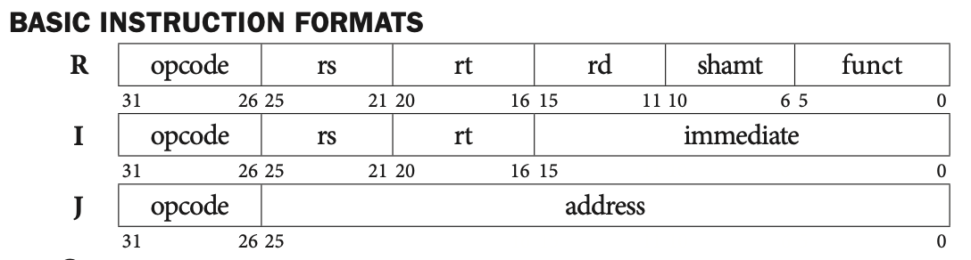
What is this MIPS instruction?
In binary:
00000000000010000100000000100000
opcode

Slide 4
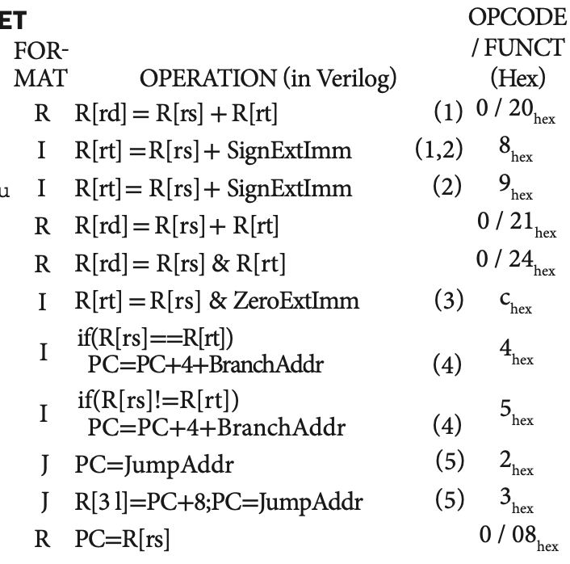
What is this MIPS instruction?
In binary:
00000000000010000100000000100000
opcode

Slide 5
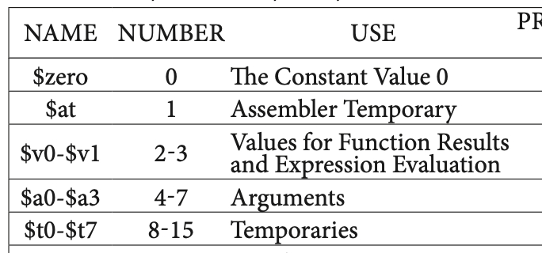
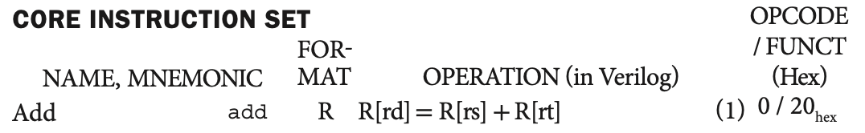
What is this MIPS instruction?
In binary:
000000 00000 01000 01000 00000 100000
opcode
rs
rt
rd
shamt
funct

Slide 6
What is this MIPS instruction?
In binary:
000000 00000 01000 01000 00000 100000
In assembly:
add $t0, $zero, $t0
opcode
rs
rt
rd
shamt
funct

Slide 7
Operation (in Verilog)
// Instantiate array ‘mem’ that contains 32
// entries of 16-bit registers.
reg [15:0] mem[0:31]; // C: unsigned short mem[32];
MIPS Green Card:
reg [31:0] R[0:31]; // “Register File”
Add’s Operation: R[rd] = R[rs] + R[rt];
R[8] = R[0] + R[9]; // when rd=8, rs=0, rt=9

Slide 8
What is this MIPS instruction?
In binary:
00100000000100001111111111111111
opcode

Slide 9
What is this MIPS instruction?
In binary:
001000 00000 10000 1111111111111111
opcode
rs
rt
immediate

Slide 10
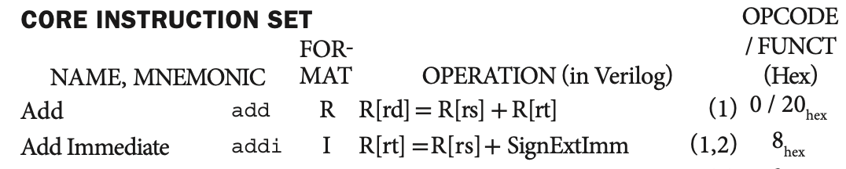
What is this MIPS instruction?
In binary:
001000 00000 10000 1111111111111111
In assembly:
addi $s0, $zero, -1
opcode
rs
rt
immediate

Slide 11
MIPS Instruction Formats
R-format:
add $rd, $rs, $rt
shifts: sll $rd, $rt, <shamt>
I-format:
addi $rt, $rs, <imm>
mem: sw $rt, <imm>($rs)
branch: beq $rs, $rt, <imm>
J-format:
j <addr>

Slide 12
Exercise Q3
I-format (<op> $rt, $rs, <imm>):
addi $s1, $s2, 1
In binary:
opcode
rs
rt
immediate

Slide 13
Exercise Q3
I-format (<op> $rt, $rs, <imm>):
addi $s1, $s2, 1
In binary:
001000 10010 10001 0000000000000001
opcode
rs
rt
immediate

Slide 14
Exercise Q3
I-format (<op> $rt, $rs, <imm>):
addi $s1, $s2, 1
In binary:
001000 10010 10101 0000000000000011
opcode
rs
rt
immediate

Slide 15
MIPS Instruction Formats
R-format:
add $rd, $rs, $rt
shifts: sll $rd, $rt, <shamt>
I-format:
addi $rt, $rs, <imm>
mem: sw $rt, <imm>($rs)
branch: beq $rs, $rt, <imm>
J-format:
j <addr>

